Slide 1
CIRCULAR LINKED LIST

Slide 2
Circular Linked List:
Each node has two parts data and next.
Here, last node contains address of first node in next part.
A head node has the address of the first node.
Head Node
100
1
200
4
300
8
100
100
200
300

Slide 3
CIRCULAR LINKED LIST
The structure of node is defined as:
struct node
{
int num;
struct node *next;
};
Here data part num contains integer value and next pointer stores the address of the next node.

Slide 4
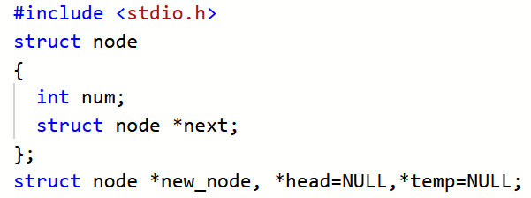
CREATION OF CIRCULAR LINKED LIST

Slide 5
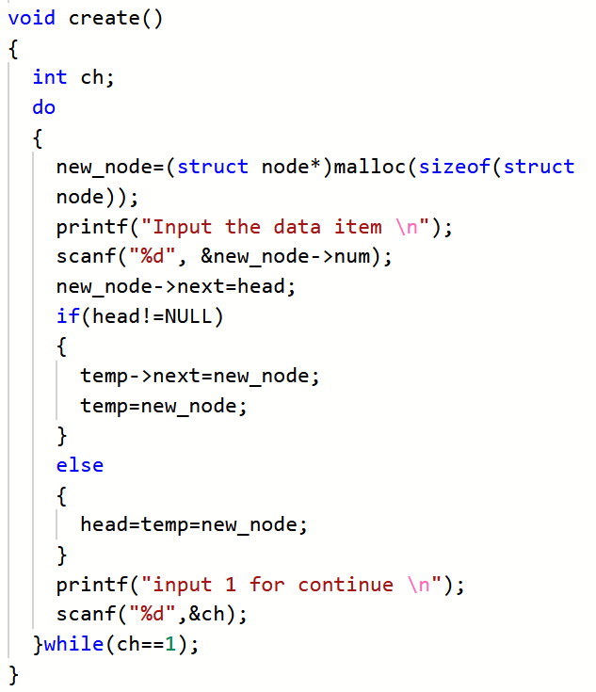

Slide 6
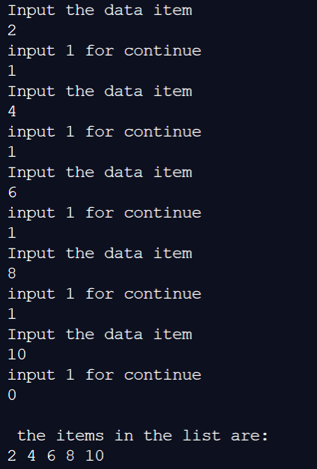
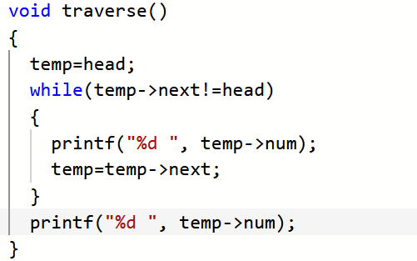
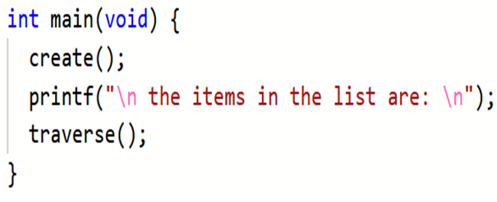

Slide 7
INSERTION AT THE BEGIN
Head Node
100
2
200
4
300
6
100
100
200
300
1
New Node
400
Head Node
400
1
100
2
200
4
300
6
400
400
100
200
300

Slide 8
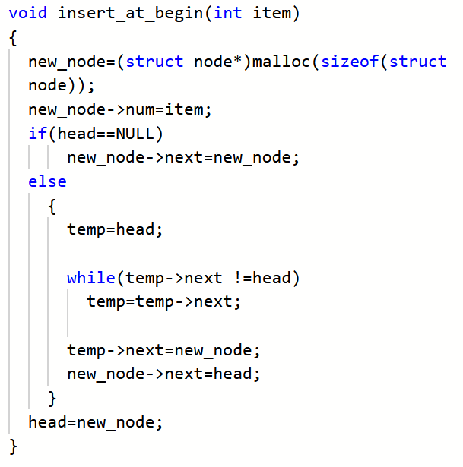

Slide 9
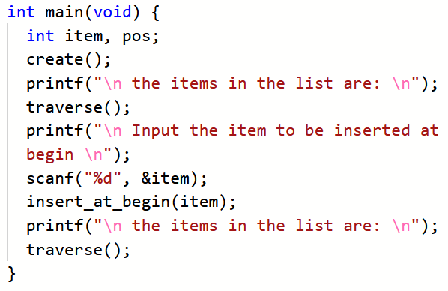
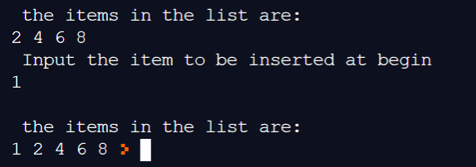

Slide 10
INSERTION AT THE END
Head Node
100
2
200
4
300
6
100
100
200
300
9
100
New Node
500
Head Node
100
2
200
4
300
6
500
9
100
100
200
300
500

Slide 11
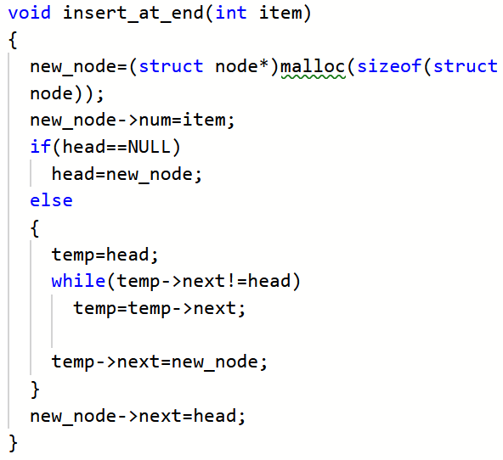

Slide 12
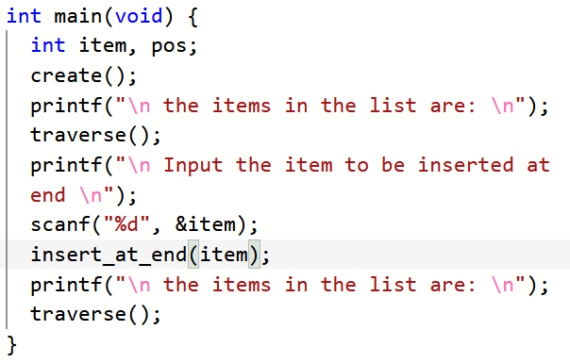
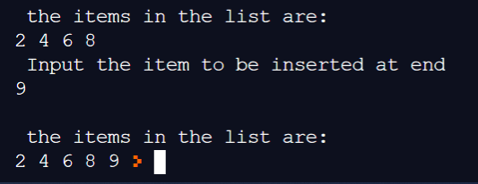

Slide 13
INSERTION AT SPECIFIED POSITION
Head Node
New Node
5
100
500
2
200
4
300
6
100
100
200
300
Head Node
100
2
200
4
500
5
300
6
100
100
200
500
300

Slide 14
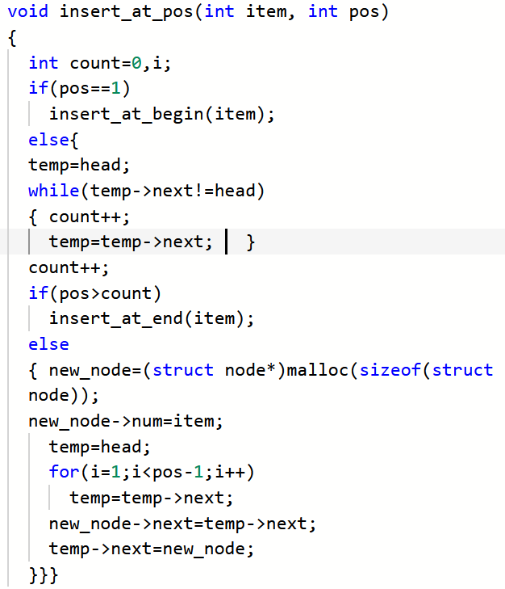

Slide 15
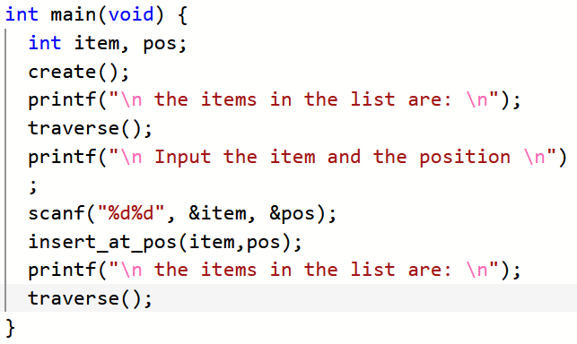
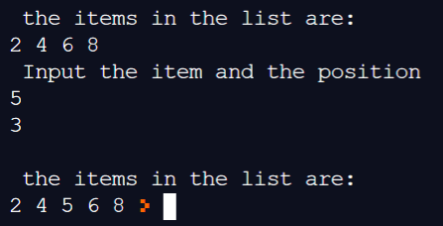

Slide 16
DELETE FROM BEGIN
Head Node
100
2
200
4
300
6
100
100
200
300
Head Node
100
4
300
6
200
200
300

Slide 17
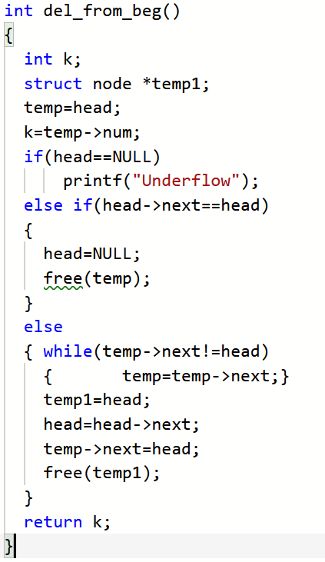

Slide 18
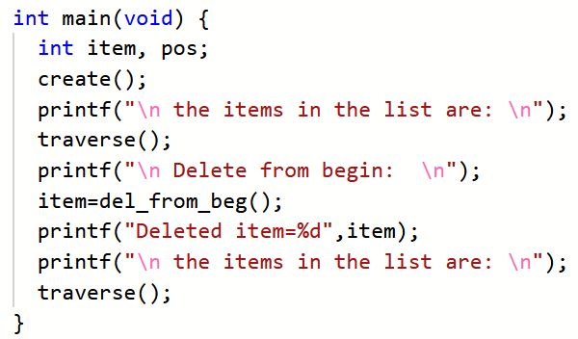
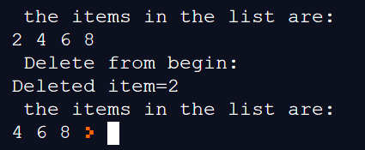

Slide 19
DELETE FROM END
Head Node
100
2
200
4
300
6
100
100
200
300
Head Node
100
2
200
4
100
100
200

Slide 20
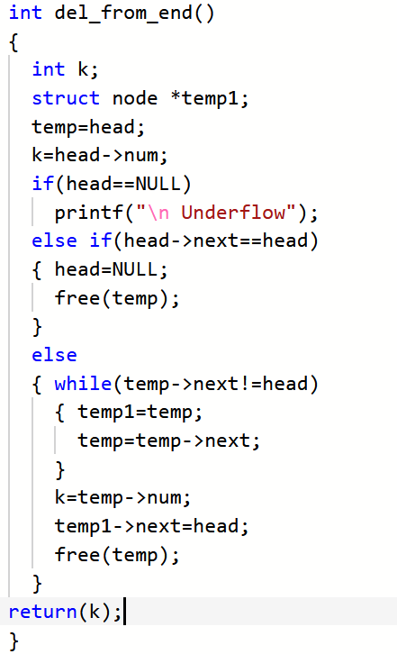

Slide 21
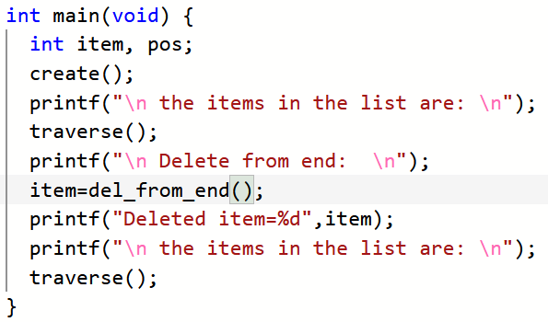
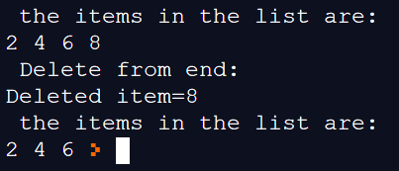

Slide 22
DELETE FROM SPECIFIC POSITION
Head Node
100
2
200
4
300
6
400
8
100
100
200
300
400
Head Node
100
2
200
4
400
8
100
100
200
400

Slide 23
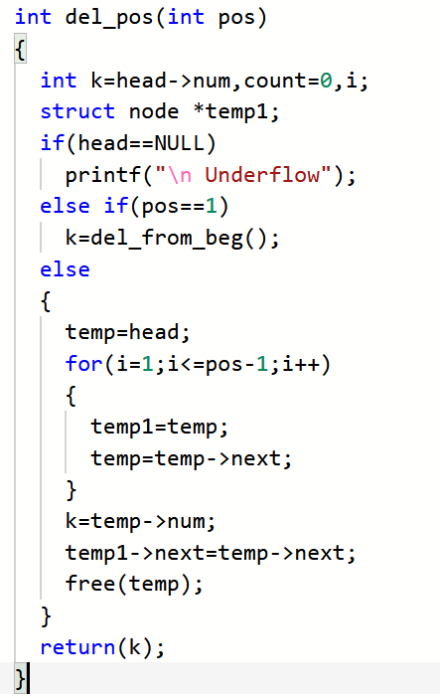

Slide 24
